Slide 1

Supermarket System
Mingyue Zhao
Jingran Zhao
Notes:
Android help tonight 7 – 8 PM

Slide 2




Introduction
Supermarket system - Simulate supermarket operations
Product Management
Warehouse Management
Sales Management (on shelves)
Customer Management
Customer Purchase Behavior
Purchase Record Inquiry

Slide 3
Sub-package 1
Product Management

Slide 4

Sub-Package 1 Module 1 -- Warehouse Management
Description: Handles products in the warehouse.
Functions:
Product Entry
Add new products to the warehouse
Product Exit
Perform exit operation if stock is sufficient
Inventory Display
Show details of warehouse products

Slide 5

Sub-Package 1 Module 2 -- Sales Management
Description: Manages products on shelves.
Functions:
New Product Shelving
Add products from warehouse to shelves
Modify Sale Price
Update prices for shelf products.
Adjust Shelf Quantity
Increase or decrease shelf product quantities
Products Display
Show details of products on shelves

Slide 6
Sub-package 2
Customer Management

Slide 7

Sub-Package 2 Module 1 -- Purchase Management
Description: Enables customer shopping activities.
Functions:
Product Browsing
View products available on shelves
Product Selection
Add or remove items from shopping cart
Checkout
Process and finalize customer purchases

Slide 8
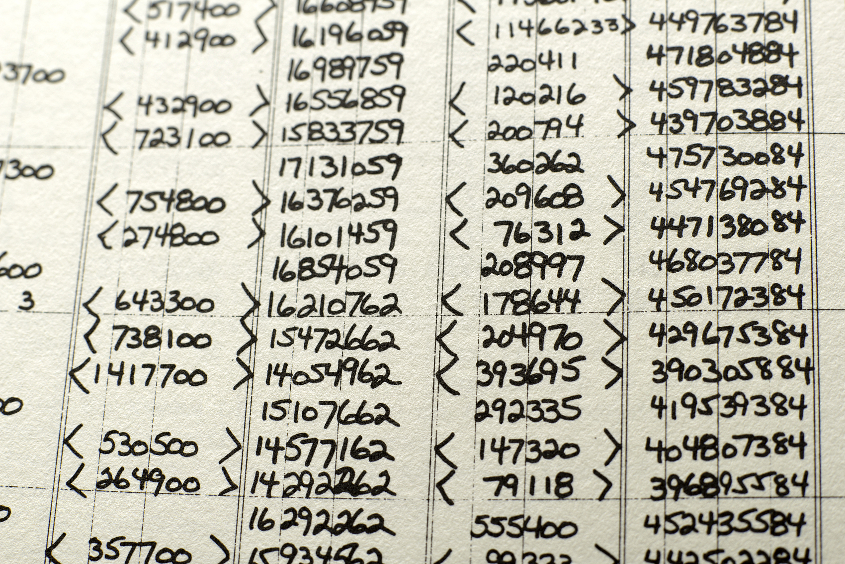
Sub-Package 2 Module 2 -- Records Management
Description: Tracks customer purchase history and spending insights
Functions:
Add Record
add a purchase record
Purchase History
View historical purchase records
Customer Spending Insights
Provide spending statistics
Store Profit Analysis
Analyze sales and popular products

Slide 9
Logic
Module: Sales Management
function: add_newproduct()
Id, quantity, sale_price
Add Product
Inventory Display
Add to shelf
Module: Warehouse Management
function: add_product()
(Id, name, category, purchase_price, entry_date, quantity)
Module: Warehouse Management
function: display()
Records
Checkout
Customer Selects
Module: Records Management
function: get_history(), get_total(),
supermarket_situation()
Module: Purchase Management
function: checkout()
other functions needed: add_record()
recording: membership, items’ information
total_cost, profit
Module: Purchase Management
function: choose()
other functions needed: display()
recording: name, sale_price, quantity,
purchase_price

